Slide 1
SELECTing Your Data

Slide 2

Overview
Querying the data
Selecting fields of interest Retrieving distinct values Formatting considerations

Slide 3



How Do We Retrieve Information?
Database
Airline on-time performance data
Query
SQL is used to retrieve the relevant data
Results
What flights departed from a certain airport?

Slide 4



Formatting SQL Queries
Strive for consistent formatting
Emphasis on readability
Use UPPERCASE for SQL keywords

Slide 5
Keywords
Reserved words that tell SQL to do something

Slide 6
SELECT allows us to retrieve data
Select the data of interest Specify fields
SELECT

Slide 7
◀ SELECT can perform calculations without a table
> SELECT 2+2;
4

Slide 8
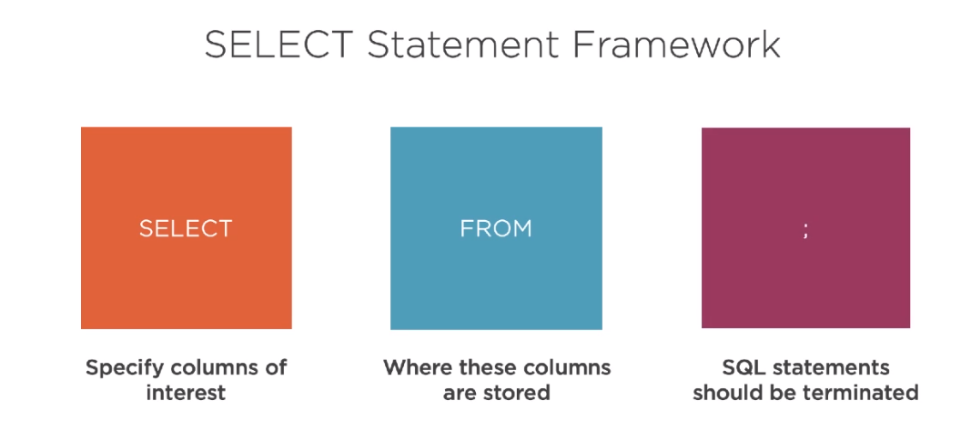

Slide 9
SELECT * FROM tablename
The Wildcard
The asterisk (*) serves as a wildcard
Returns all columns from a given table

Slide 10

Demo
Selecting all columns
Using the wildcard

Slide 11
Use the wildcard sparingly when writing queries

Slide 12
Explicitly list specific columns of interest
Increases readability
Explicit Notation
Makes code easier to troubleshoot

Slide 13
List each column after the SELECT keyword
Separate each column with a comma
Specifying
Fields

Slide 14
SELECT first_name, last_name
FROM person;
Querying Specific Fields
Code returns first name and last name for every record in person table
SELECT keyword specifies fields of interest FROM specifies table where records are stored

Slide 15
Demo
Selecting specific columns

Slide 16
Distinct values
Unique values in a database

Slide 17
Identifying Distinct Values
Class Roster Distinct names
SELECT first_name FROM students;
SELECT DISTINCT first_name FROM students;
first_name
Alec Amy Amy Jason Katie Katie Katie Shannon
first_name
Alec
Amy
Jason
Katie
Shannon

Slide 18
Demo
Select distinct values
Apply alias to columns

Slide 19
Summary
SELECT returns fields from the database
FROM prescribes the table to use DISTINCT limits to unique values

